Slide 1

Software Costing
Secrets of the software masters

Slide 2
How Much to Develop Software?
Historical data:
  10-30 LOC per person-day
  largely invariant of the language
  includes all development activities
Need estimates of:
  each phase
  each type of activity
May want variations by complexity, size, etc.

Slide 3

Factors Affecting Software Cost
Complexity and required reliability
Capabilities/experience of development team
Methods, tools and development environment
Size of the software
Performance
Project standards

Slide 4
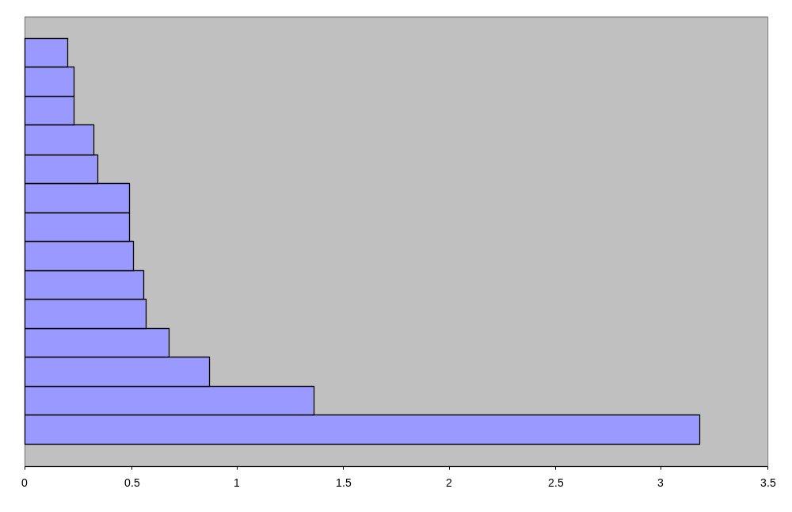
Software Productivity Range
1.20
Language experience
1.23
Schedule constraint
1.23
Database size
1.32
Turnaround time
1.34
Virtual machine experience
1.49
Virtual machine volatility
1.49
Software tools
1.51
Modern programming practice
1.56
Storage constraint
1.57
Applications experience
1.66
Timing constraint
1.87
Required reliability
2.36
Product complexity
Personnel/team capability
4.18
1.00 1.50 2.00 2.50 3.00 3.50 4.00
Notes:
This chart shows the range of project productivity due to some of the factors which cost models use.
The number shows the multiplicative effect that each factor can have.
For example, the effect of “software tools” between a project with very poor tools, and a project with very good tools represents a difference of 49% in extra labour costs to to the project with very poor tools. Usually this extra labour cost would more than pay for the tools, if the management is aware of these cost implications.
Most job advertisements request language or operating systems experience. Are these the most important factors, according to this chart?
Which factors could be impacted by good management? How?
Is it cost effective, according to this, to pay more salary to hire more capable personnel?

Slide 5
Bottom-up Approach
Define the tasks to a detailed level
Estimate each work package based on past projects
Refine with multiple estimates and reviews
Estimates are done for the bottom level of the Work Breakdown Structure (WBS)
  project and phase costs are determined by rolling up costs to the top of the WBS.

Slide 6
Work Breakdown Structure
Build email system
Requirements
analysis
Code &
Unit Test
Integration
& Test
Design
User
Interface
Reports
Database
Queries

Slide 7
Problems with the bottom-up approach
Requires a detailed WBS
Very expensive to produce
  500 individual estimates for a 100 KLOC program
Usually results in double counting
Sensitive to individual experience/capabilities
Ignores diseconomies of scale

Slide 8
Top-down Approach to Software Estimating
Uses parametric cost models
Identifies a relevant set of cost drivers
Impact of each cost driver is derived from past projects
Mathematical models are developed to estimate development cost

Slide 9
COCOMO
Contructive Cost Model (COCOMO) by Barry Boehm, Software Engineering Economics (1981)
Inputs:
  software size in DSI
  mode: embedded, semi-detached or organic
  estimates of 14 other cost drivers
Outputs:
  overall and phase estimates of development effort and duration
  estimates of distribution of effort in each phase to major activities

Slide 10
Major Steps in COCOMO Modeling
Generate
Nominal
Estimate
Distribute
estimate
to phases
Estimate
inputs
Assign
effort to
activities
Adjust for
cost
drivers

Slide 11
Step (1) Estimate Inputs
Size: based on past experience of similar software
Mode: compare with mode definitions
Cost Drivers: from cost driver definitions

Slide 12
Development Mode
Organic Mode
Embedded Mode
Semidetached Mode
Notes:
Organic Mode: characterised by a stable development environment, with minimal concurrent development of related hardware. Simple design requirements for interface and data processing along with a low priority con completion schedule.
Embedded Mode: characterised by tight constraints. Must operate within a complex of hardware, regulations and operational procedures. In short, the software is expected to conform to the environmental specifications. Embedded software typically is expected to absorb more changes and requires a higher level of development effort.
Semidetached Mode: Between organic and embedded modes. Occurs when a blend of the characteristics of the organic and embedded exists.

Slide 13
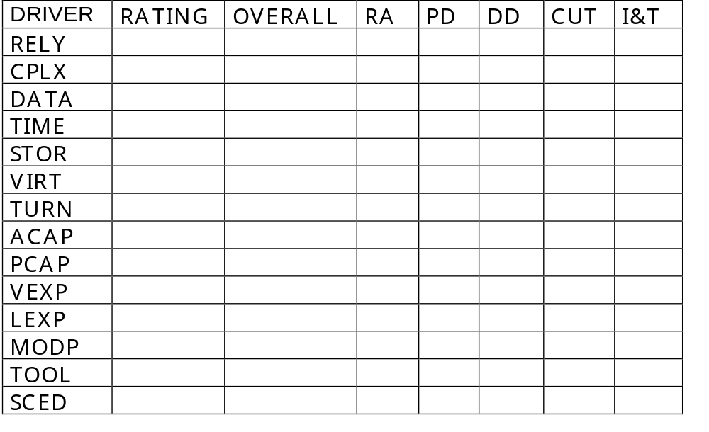
Table of Cost Drivers
Multiply the numbers of a column together to get the effect of all of the factors on the phase corresponding to the column.

Slide 14
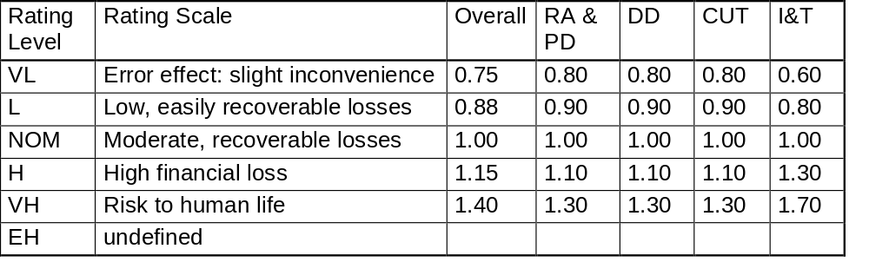
RELY - Required Reliability
How reliable the system needs to be, based on the severity of failure consequences

Slide 15
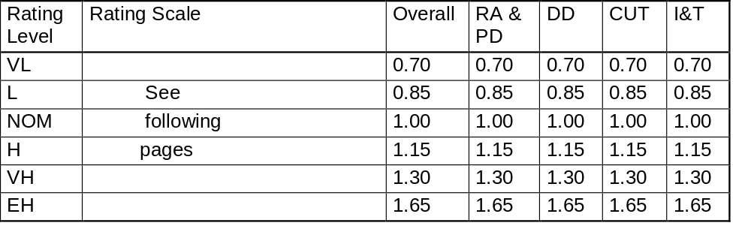
CPLX - Complexity
How complex the software will be: control, computational, device dependent, and data complexity

Slide 16
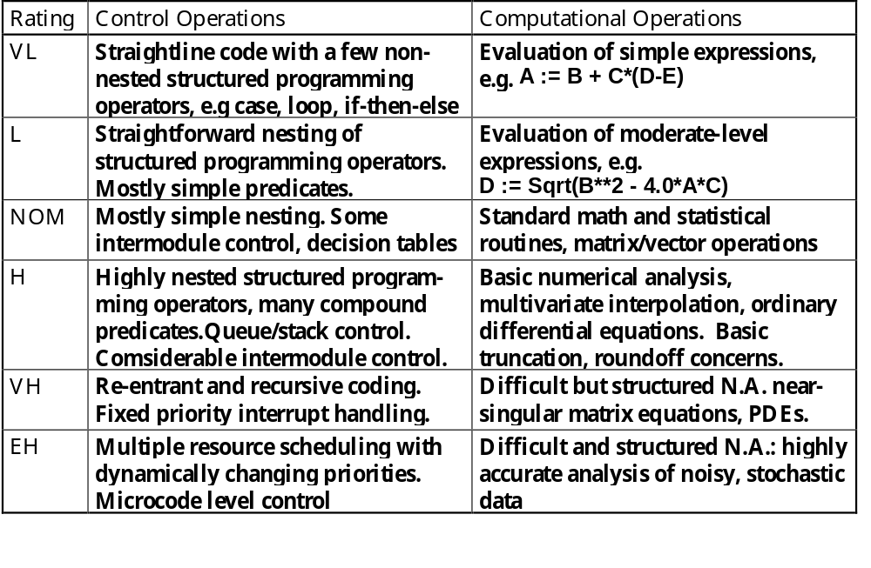
Complexity Ratings (page 1)

Slide 17
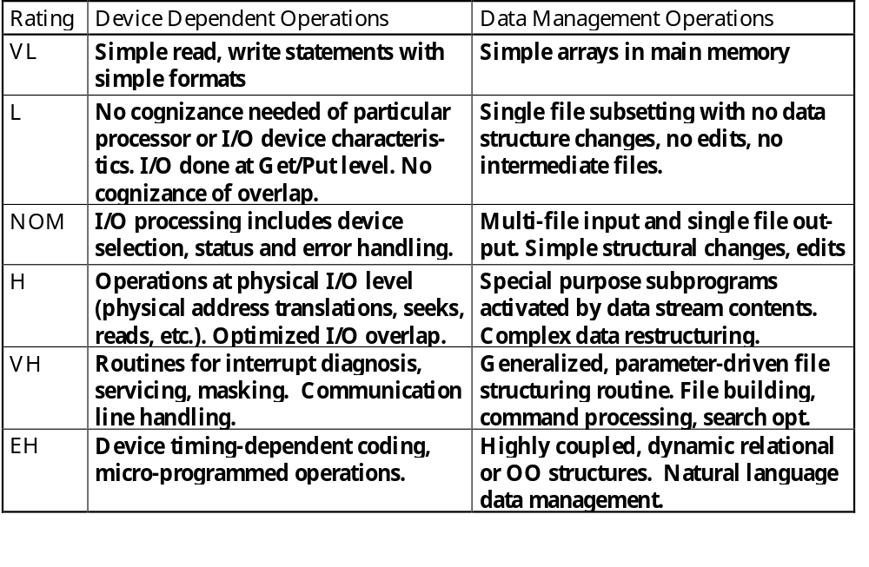
Complexity Ratings (page 2)

Slide 18
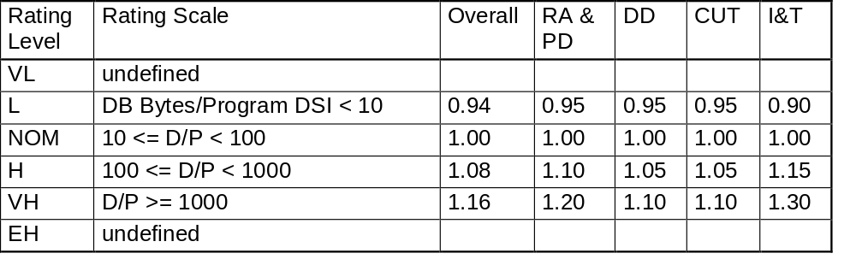
DATA - Relative Size of Data Base
Size of the data base relative to the size of the software

Slide 19
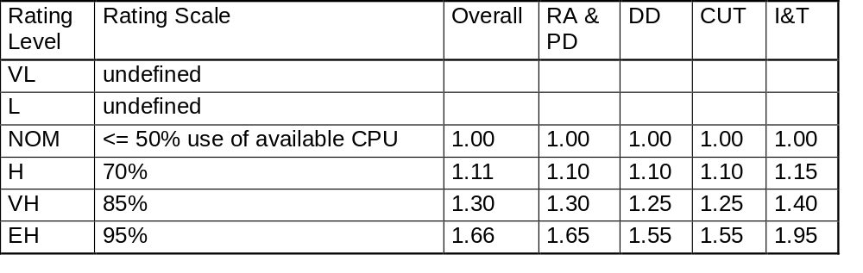
TIME - Required % CPU Usage
How efficient the software will need to be, looking at the percent load it will place on the processor

Slide 20
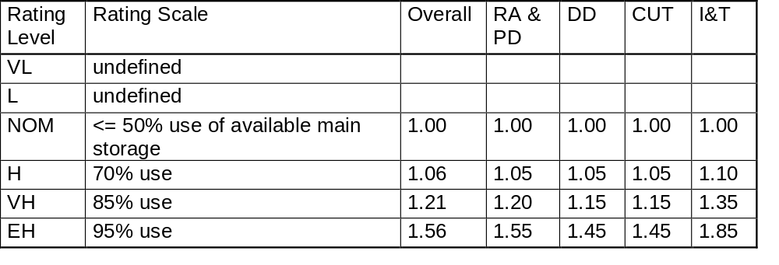
STOR - Required % Memory Usage
How efficient the software will need to be, looking at the percent of memory it will use

Slide 21
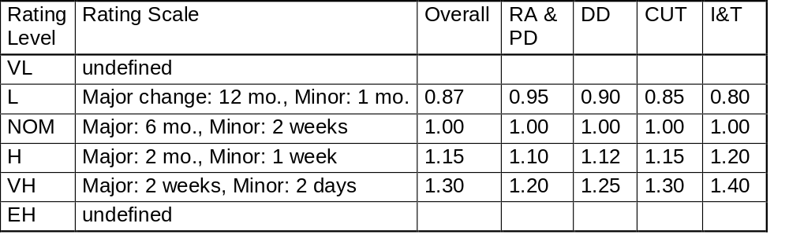
VIRT - Virtual Environment Volatility
How many changes there will be in the development environment (development machine and target)

Slide 22
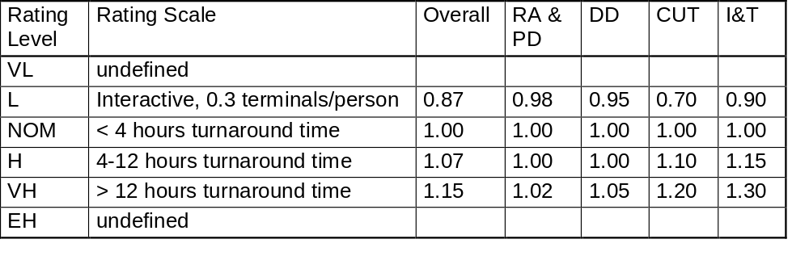
TURN - Turn Around Time of Development Environment
How quickly you can get actions done in the development environment

Slide 23
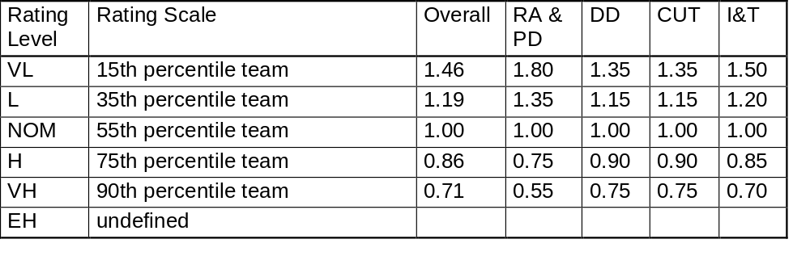
ACAP - Analyst Capability
Generic capabilities of the analyst, relative to other analysts

Slide 24
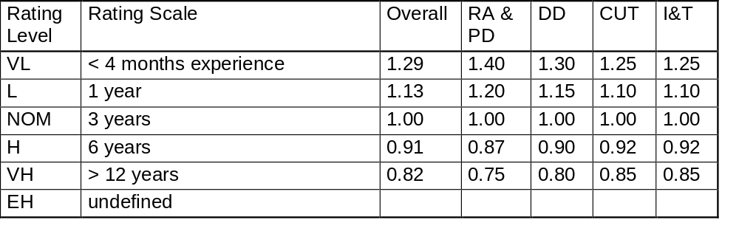
AEXP - Applications Experience
Average project staff experience with the type of application being developed at the start of the project

Slide 25
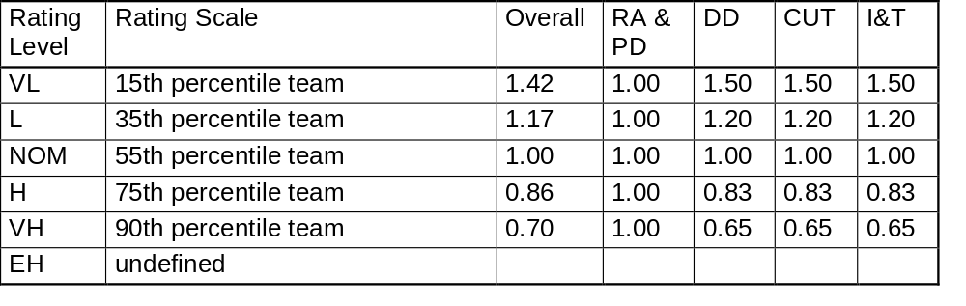
PCAP - Programmer Capability
Programmer capabilities, relative to other programmers

Slide 26
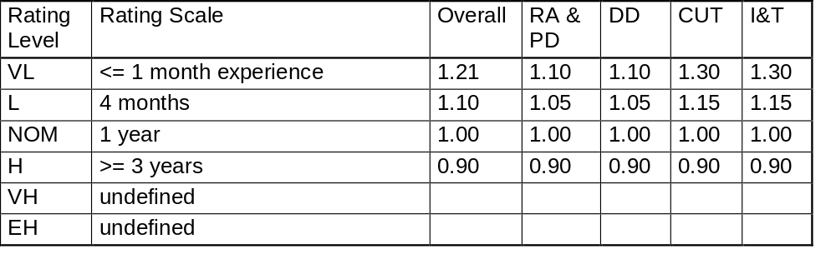
VEXP - Experience with Virtual Environment
Average project staff experience with the development environment (computers, OS, utilities, tools, target system)

Slide 27

LEXP - Experience with Language
Average project staff experience at the start of the project with the computing language

Slide 28
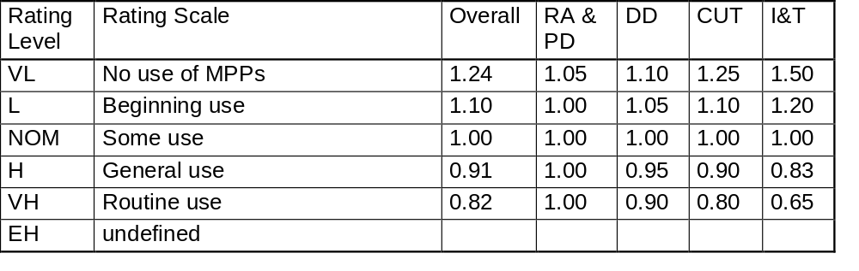
MODP - Use of Modern Software Practices
Extent to which current techniques and methods will be used on the project

Slide 29
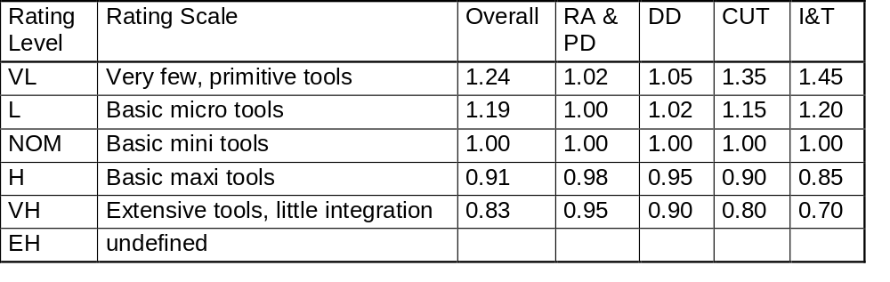
TOOL - Use of Tools
Extent to which tools will be used to support the development process

Slide 30
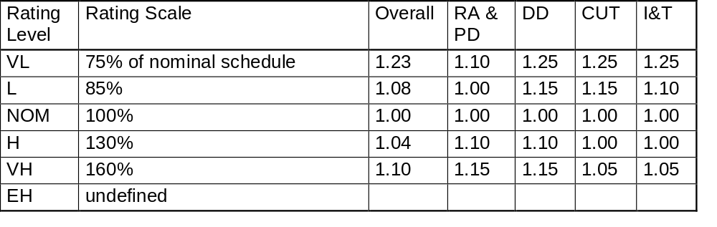
SCED - Schedule
Whether the schedule must be shortened or can be extended from nominal

Slide 31
Step 2: Generate Nominal Estimate
Generate
Nominal
Estimate
Distribute
estimate
to phases
Estimate
inputs
Assign
effort to
activities
Adjust for
cost
drivers

Slide 32
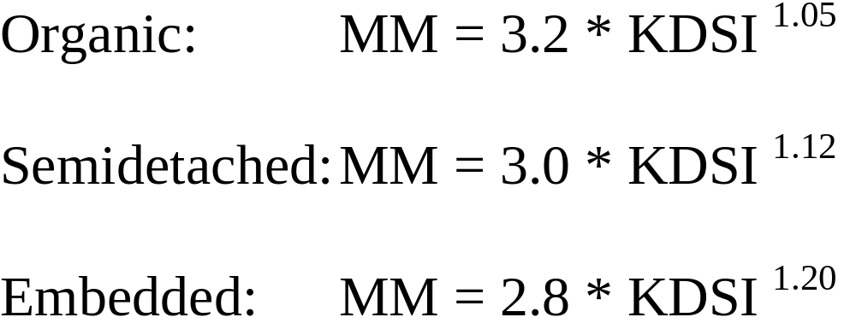
Step 2: Generate Nominal Effort
MM is effort in man-months, or person-months

Slide 33
Step 3: Distribute Effort to Phases
Generate
Nominal
Estimate
Distribute
estimate
to phases
Estimate
inputs
Assign
effort to
activities
Adjust for
cost
drivers

Slide 34
COCOMO Software Size Classification
Classification of software by size:
small (S) 2 KDSI
Intermediate (I) 8 KDSI
medium (M) 32 KDSI
large (L) 128 KDSI
very large (VL) 512 KDSI

Slide 35
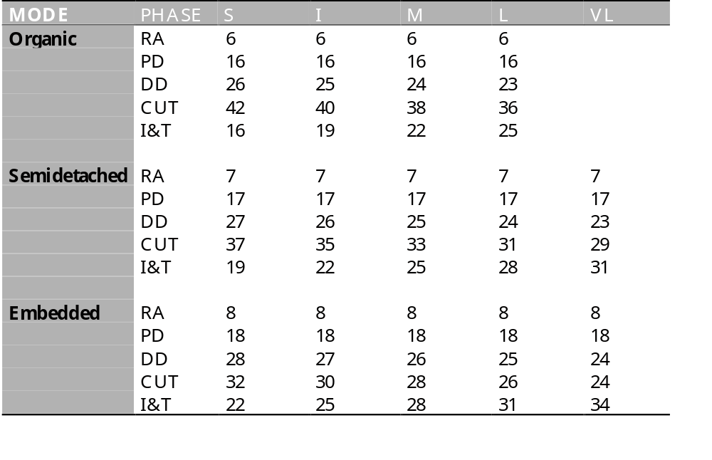
Step 3: Distribute Nominal Effort to Phases
Entries are percentage of the effort given in the Nominal Effort equation.

Slide 36
WBS with Effort,
Distributed to Phases
Cruise Control
System
Requirements
Preliminary
Detailed
Code and Unit
Integration
Analysis
Design
Design
Test
and Test
(10000) - 366 md
(20000) - 1222 md
(30000) - 1522 md
(40000) - 1328 md
(50000) - 1164 md

Slide 37
Step 4: Apply Multipliers
Generate
Nominal
Estimate
Distribute
estimate
to phases
Estimate
inputs
Assign
effort to
activities
Adjust for
cost
drivers

Slide 38
Step 4: Apply Multipliers Associated with the Cost Drivers
Effort multiplier for each phase of the life cycle:
  the product of the multipliers for each cost driver from the earlier tables
Example:
  Mult(RA) = Mult(RA,RELY) * Mult(RA, CPLX) * ... * Mult(RA, SCHED)

Slide 39
Step 5: Divide Effort Among Activities
Generate
Nominal
Estimate
Distribute
estimate
to phases
Estimate
inputs
Assign
effort to
activities
Adjust for
cost
drivers

Slide 40
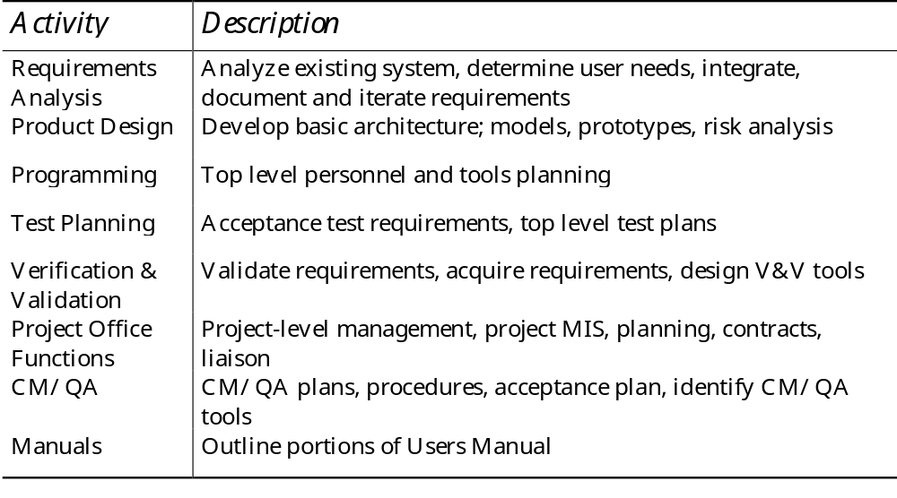
Activities During RA Phase

Slide 41
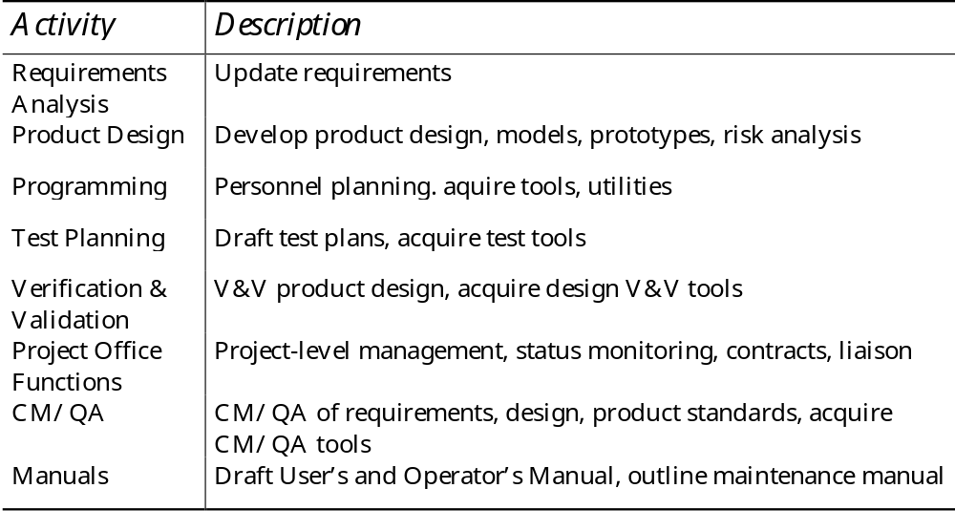
Activities During PD Phase

Slide 42
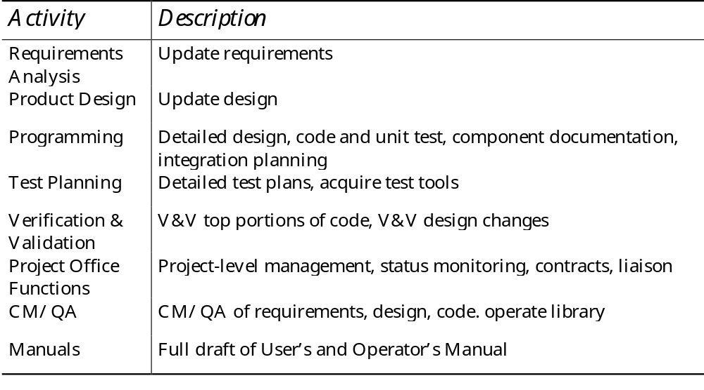
Activities During DD and CUT Phases

Slide 43
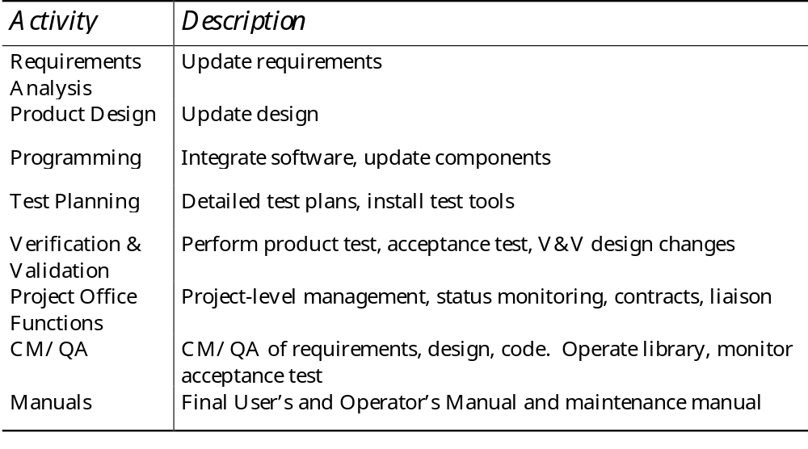
Activities During I&T Phases

Slide 44
Step 5: Divide Phase Effort Estimates Among Activities
Activities are the major types of work done during development:
  requirements analysis, product design, programming, test planning, verification and validation, project office, CM/QA, writing manuals
Activity distribution varies with
  life cycle phase
  development mode
  size of software
The percentage distribution of activities is given in the next 3 slides

Slide 45
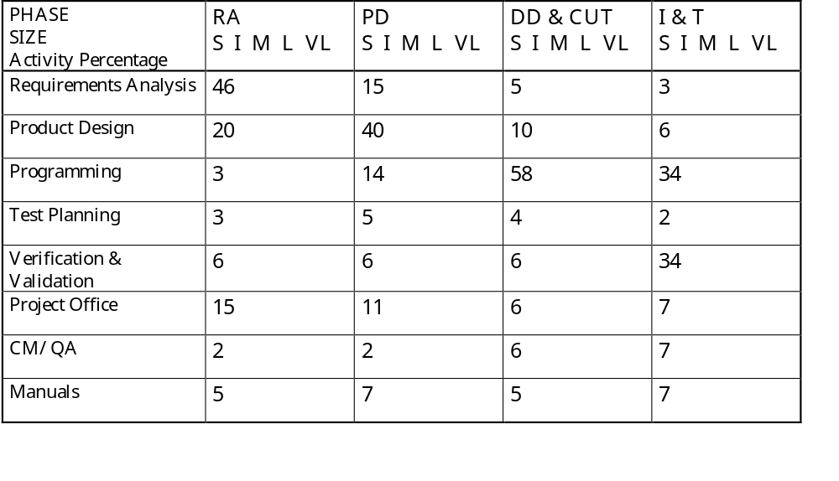
Activity Distribution (Organic)
Entries are percentage of the adjusted effort for the corresponding phase.

Slide 46
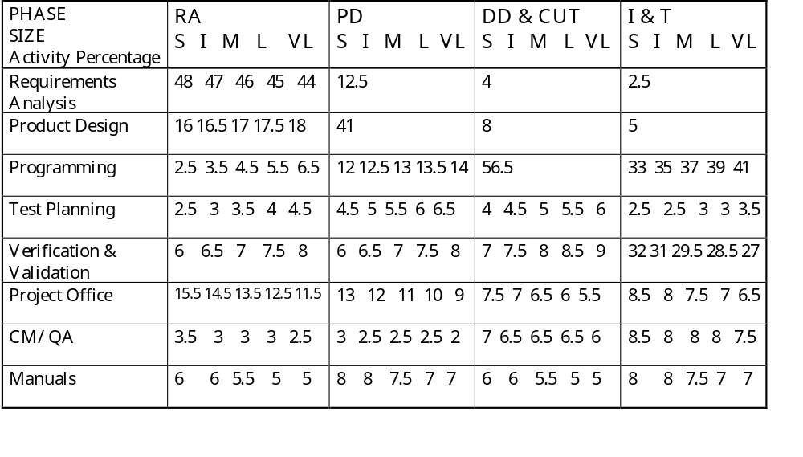
Activity Distribution (Semi-detached)
Entries are percentage of the adjusted effort for the corresponding phase.

Slide 47
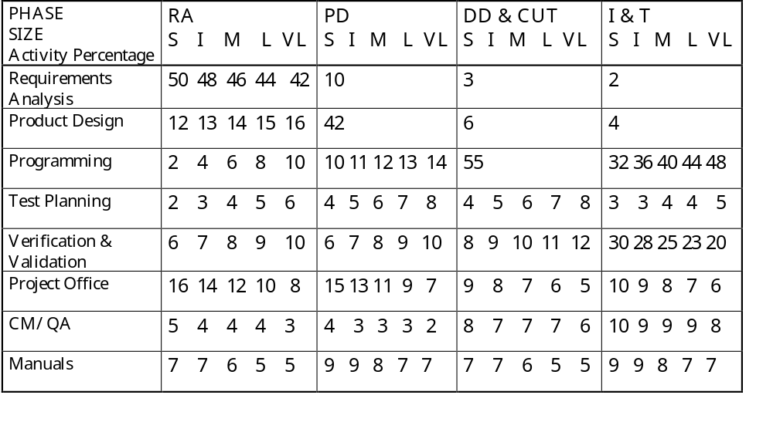
Activity Distribution (Embedded)
Entries are percentage of the adjusted effort for the corresponding phase.

Slide 48
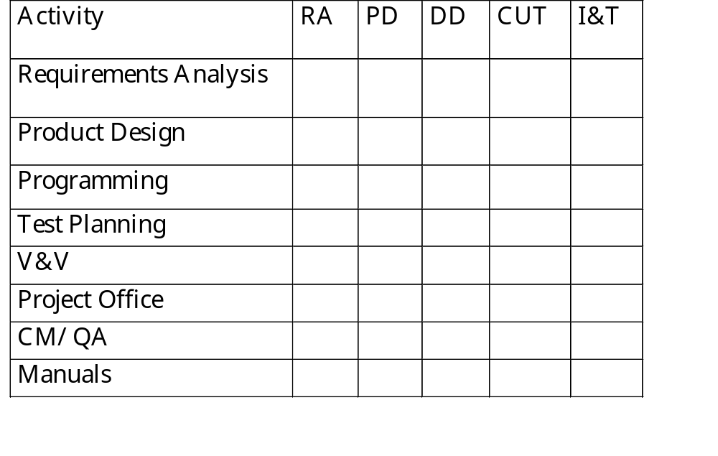
Example Work Breakdown Structure

Slide 49
Dealing with Schedule
Now we have effort allocated to phase and activity
COCOMO also estimates schedule
Percentages need to be adjusted when effort is more or less than nominal
  addendum shows details

Slide 50
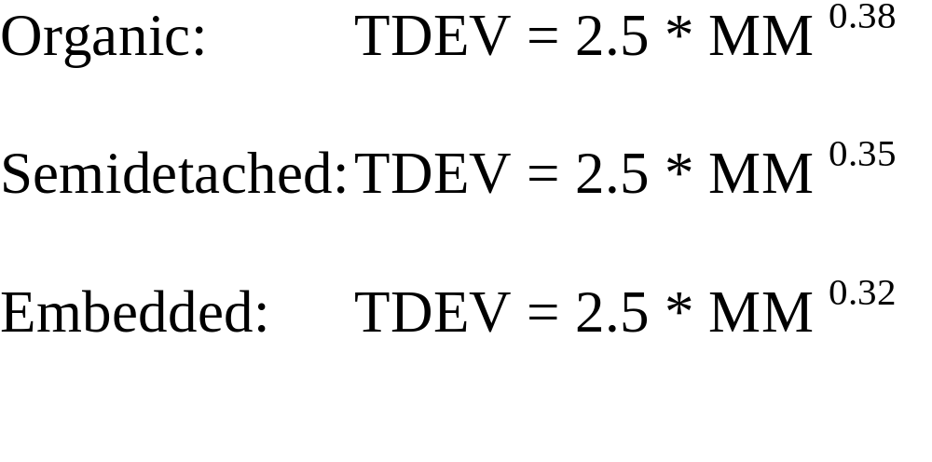
Generate Duration
MM is the project effort (all except RA), adjusted by the multipliers,
TDEV is the development time (in months) for design through test

Slide 51
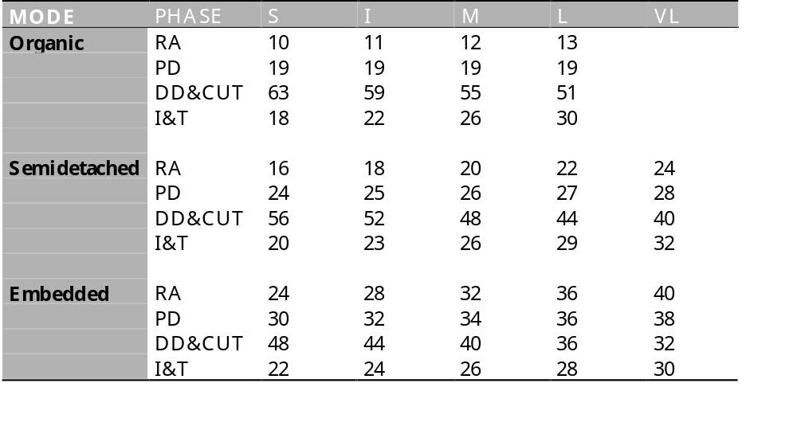
Distribute Duration to Phases
Entries are percentage of the TDEV time for the project.

Slide 52
Manpower Loading
Often need to know effort
  by month
  by activity category
Manpower loading table shows this
Divide effort for each activity by the schedule time it takes
  allocate it in a matrix

Slide 53
Issues with Parametric Models
Require an estimate of lines of code (or function points)
Large variations in estimates from different cost models
Cost drivers are subjective, and interpretation varies between analysts
Models may omit an important driver

Slide 54
Cost Model Conclusions
Cost models are only a tool
  Estimates should be backed up by experienced analysts
Estimates help explore cost variations
Must be calibrated to the organisation
Usually quicker than bottom-up estimates
  As reliable as bottom-up estimates
Drive the development into a more systematic approach
Cost models are an essential tool

